Slide 1



UNIT 2
Lesson 8
IN &OUT OF FASHION
Part 3

Slide 2
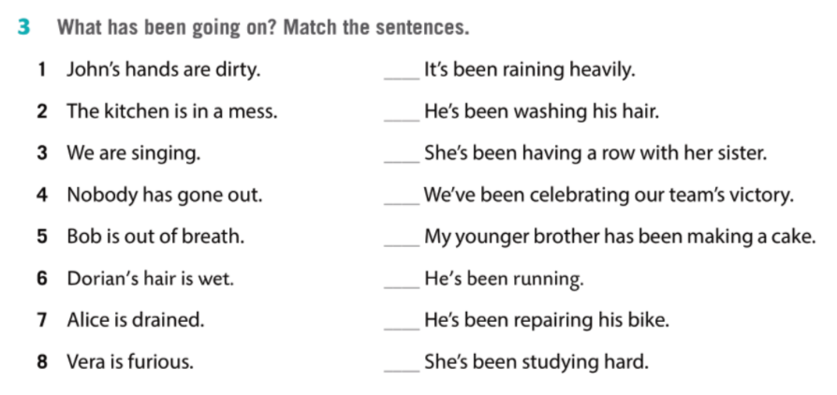
4
6
8
3
2
5
1
7

Slide 3
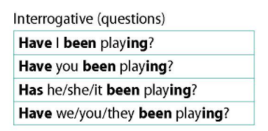
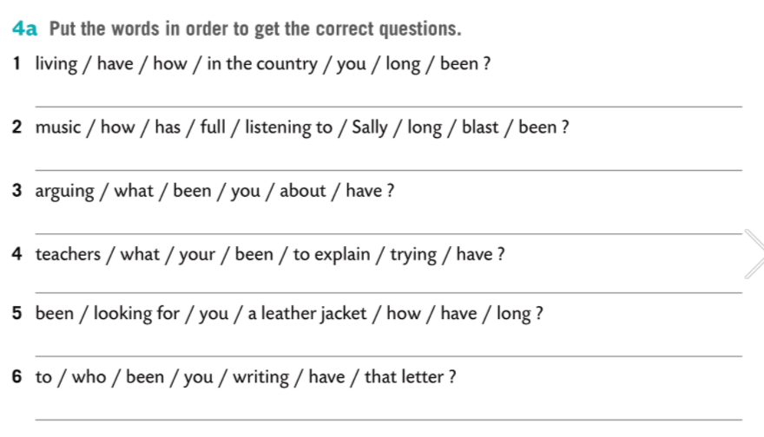
How long have you been living in the country?
How long has Sally been listening to music full blast?
What have you been arguing about?
What have your teachers been trying to explain?
How long have you been looking for a leather jacket?
Who have you been writing the letter to?

Slide 4
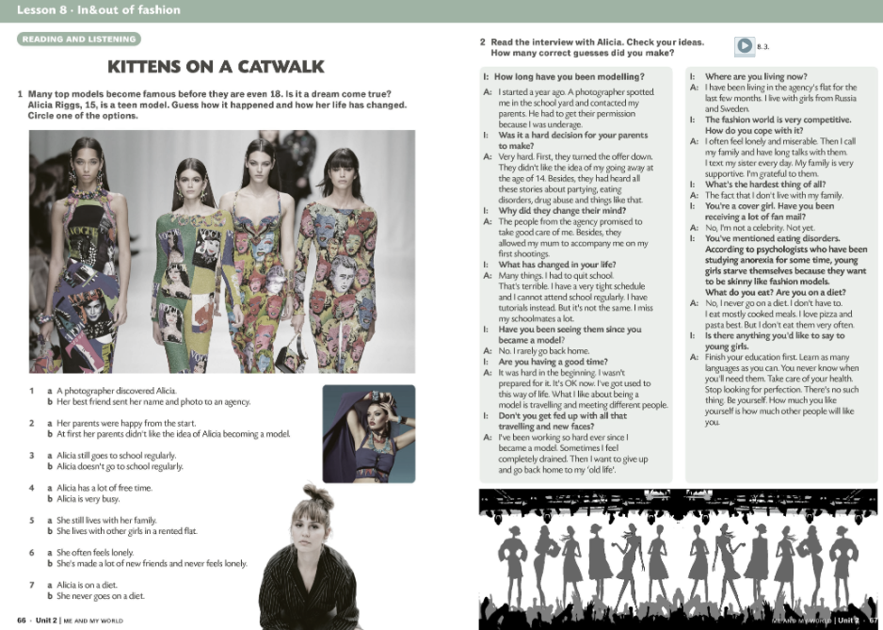


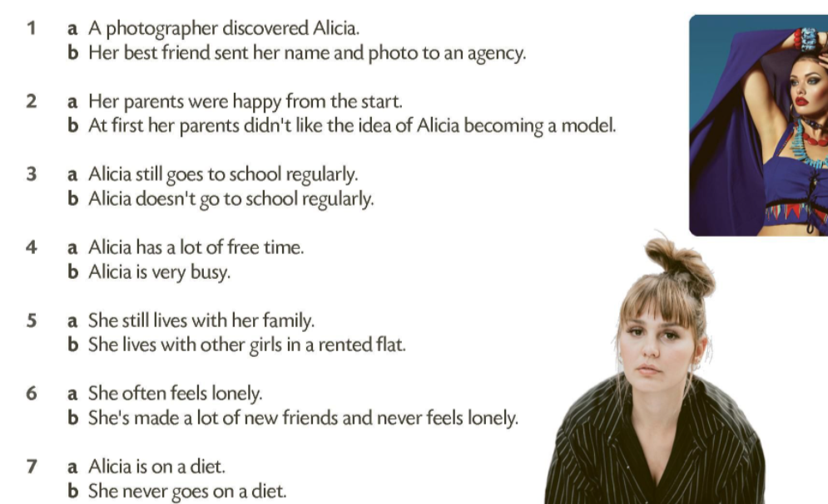
How long has she been modelling?
Where has she been living?
Who has she been meeting?
Where has she been working?
Which countries has she been visiting?

Slide 5

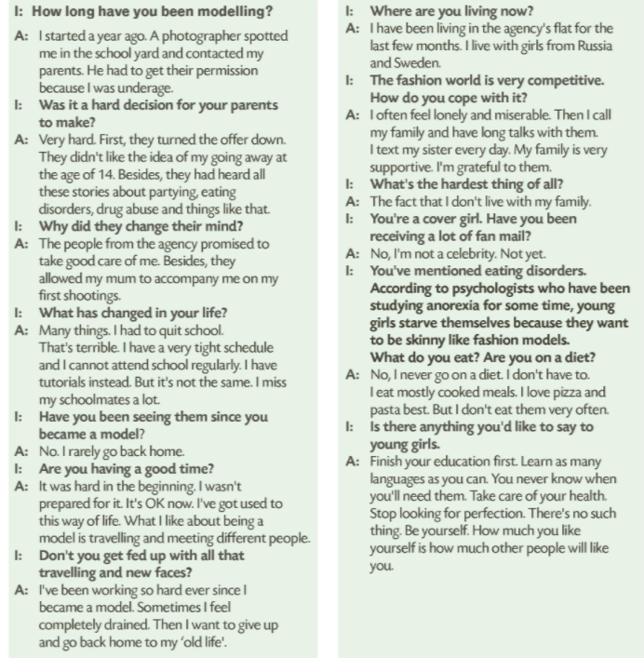


Slide 6
